Slide 1
Machine Learning to Predict Dengue Outbreaks in Singapore
Done by: Yip Jung Hon and Vivien Paitimusa.
Notes:
Good morning, I am Vivien and this is Jung Hon, and we will be showing you what we have done for this datathon.

Slide 2
Terminology
Lead time: the number of weeks in advance we wish to predict dengue cases for.
Data window: the number of weeks of data in the past we are going to make use of to make our prediction
We found the optimal data window to be 18 weeks and our goal will be to predict dengue with a lead time of 8 weeks.
Notes:
Before beginning, I will introduce some terminology that we will be using:

Slide 3
Objectives
To develop a model that takes in past and real-time temperature, rainfall, dengue and population data to give us a dengue forecast 8 weeks in the future.
To improve the model so that it is better than the baseline prediction by a significant margin.
To provide insight on which factors are most useful for predicting dengue outbreaks.

Slide 4
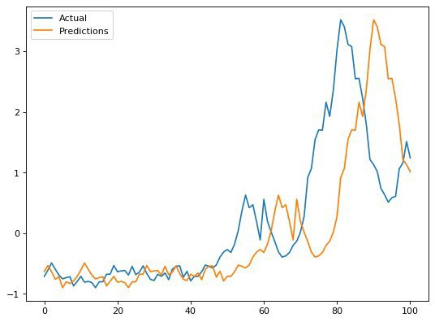
Baseline Prediction
Naive way: Predict the number of dengue cases 8 weeks in advance (t=8) using the current number of dengue cases (t=0).
Metric for loss: mean squared error
Baseline Loss: 0.9056
Notes:
A baseline prediction is the prediction of a very simple model. We took the lead time of 8 weeks and used the mean squared error as our loss metric. So, if we want our model to add any value at all, it should at least be able to beat the baseline prediction convincingly. The above graph shows the prediction for the most recent 101 weeks of dengue cases and the orange line represents the naive method of prediction. For instance, if we wanted a prediction (here), we would use the number of cases (here), which is why the graph is shifted forward by 8 timesteps.

Slide 5
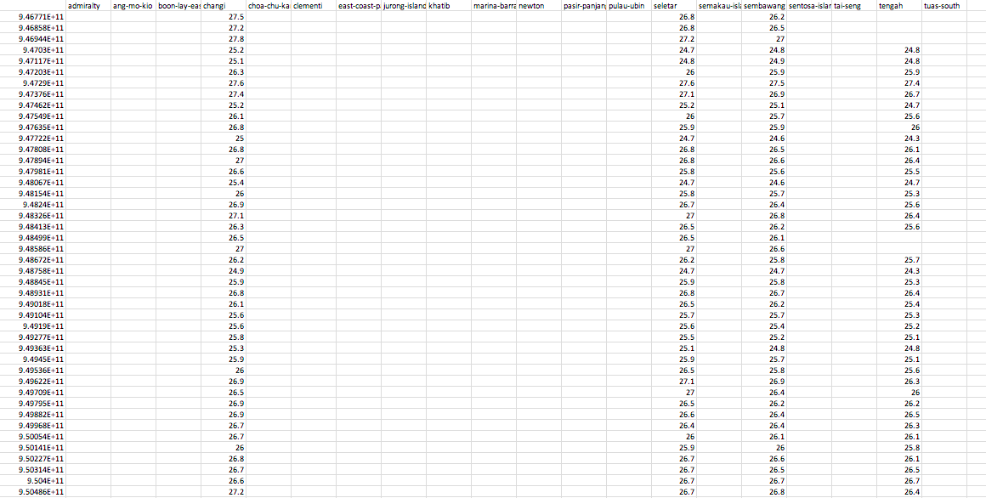
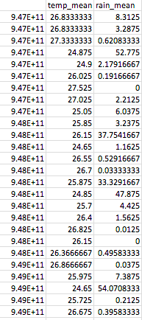
Data Processing
Merged daily temperature and rainfall data into a large .csv file and took the daily average.
Notes:
First, we merged all the separate data into a csv file to identify any missing data.
Then we took the average along each row which represents a day to help deal with missing values and reduce noise
We found no missing dates once the date was averaged (ie, every day from 1/1/2000 onwards had a entry).

Slide 6
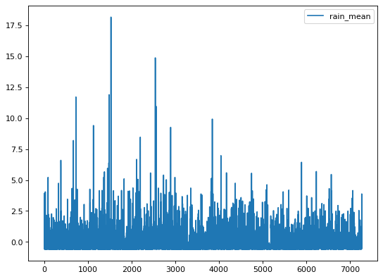
Challenges: Noise Reduction
Daily rainfall and temperature data were noisy
Problem: Using raw daily data, validation loss did not decrease.
Solution: Taking average of temperature and rainfall over disjoint intervals of 6 days.
Notes:
As you can see from the graph, which is a plot of daily mean rainfall, the rainfall is noisy. However, if noise reduction was too excessive, the model could not predict sudden spikes in the number of dengue cases. After some experimentation, we found that 6 day interval was optimal for training data.

Slide 7
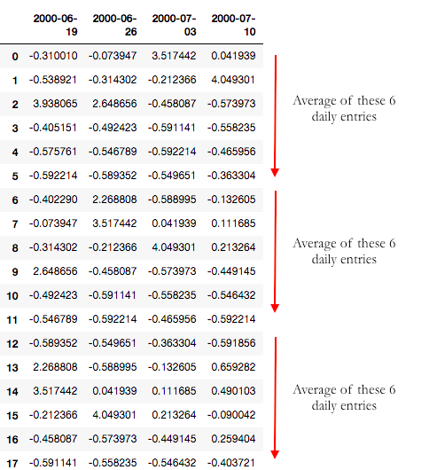
How did we do averaging?
Columns represent the date we wish to predict dengue for.
Entries represent daily rainfall collected for the data window associated with that date
Notes:
*Additional Features for Noise Reduction:
Mean, standard deviation, minimum and maximum of the temperature and rainfall over the data window of 18 weeks.
For instance, say we wanted to predict the number of dengue cases for june 19 (week 26). So, the column for this data represents the rainfall data from week 1 to 18 (exclude the latest 8 weeks of data, which is the lead time, which is data we re not supposed to have). Then we average every 6 values for noise reduction which will then be used as training data.

Slide 8
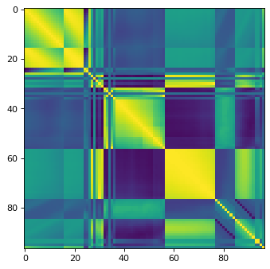
Data Analysis
Yellow represents high positive correlation while purple represents negative correlation.
Bright yellow spots suggested that suggests past dengue data is highly correlated to the future dengue cases.
Feature engineering of dengue cases to further analyse past dengue cases.
Correlation Matrix for Training Data
Notes:
Additional data processing:
From the correlation matrix, it suggests that past dengue data is highly correlated to the future dengue cases. To maximise the potential of this data, we used feature engineering on the dengue data set to further analyse past dengue cases.

Slide 9

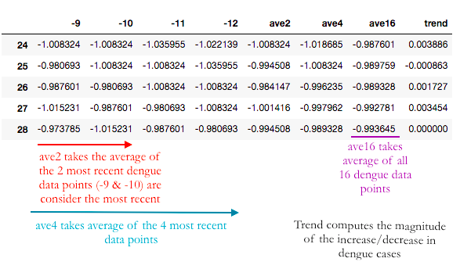




Feature Engineering for dengue cases
Hope to give a sense of “time” to the model
Hit a balance between noise reduction and too much noise reduction
Notes:
Dengue dataset may be noisy also and we want to give a sense of time to the model. For instance, if dengue cases were generally on the rise, then ave2 would show a greater number than ave8, since it averages the more recent dengue cases. Trend calculates the ‘gradient’ of the graph, so we take the most recent dengue entry - least recent dengue entry/dengue window.
By calculating a range of different averages, the model can find the most suitable for noise reduction and predicting. This also forces the model to consider other data points instead of picking a specific week for prediction, thus improving accuracy.

Slide 10
Flushing
Mean rainfall negatively correlated with future dengue cases
This might suggest that while slight rainfall might be conducive for mosquito breeding, heavy rainfalls might instead be detrimental to mosquito growth
Phenomenon called flushing, which causes dengue eggs to be washed away
Took maximum n values of rainfall

Slide 11
Flushing
Notes:
We took a range n maximum rainfall data to get a better sense of the level of rainfall for flushing to actually occur and thus the model will be better able to detect when flushing has occured.

Slide 12
Features of training data
Past weekly dengue cases and their mean for the past 18 weeks.
Indicators for dengue trends across the 18 weeks. This included ave2, ave4... as well as the trend feature.
Mean rainfall and temperature over blocks of 6 days across 18 weeks.
Mean, maximum, minimum and standard deviation of rainfall and temperature data across 18 weeks.
20 highest rainfall and temperature values within the interval of 18 weeks.
Population, month and year data.
Notes:
(Ref to code)

Slide 13
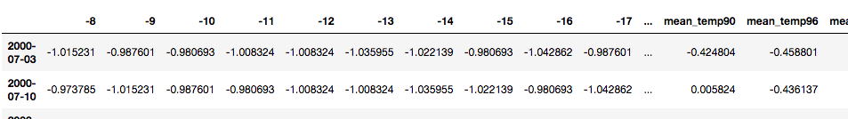
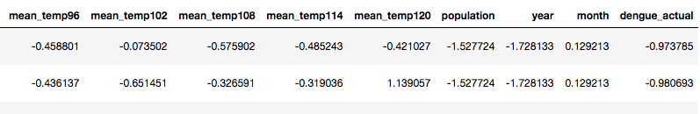
Features of training data

Slide 14
Splitting of data into train/test sets
The data consisted of 1009 weeks of recorded dengue data. It was split into 908 training sets and 101 test sets (≈0.9 ratio).
Testing involved the most recent 101 weeks of data
Notes:
For splitting of data into train/test sets (refer to code)

Slide 15
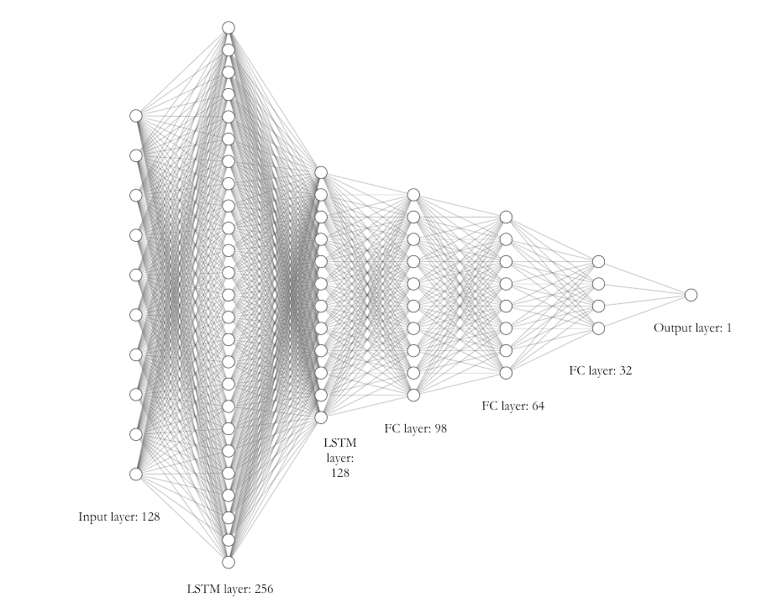
Network Architecture
5 hidden layers
First 2 layers are LSTM layers
Use SGD as optimiser
Train for 60 epochs on batch size of 64
Notes:
After many tests,

Slide 16
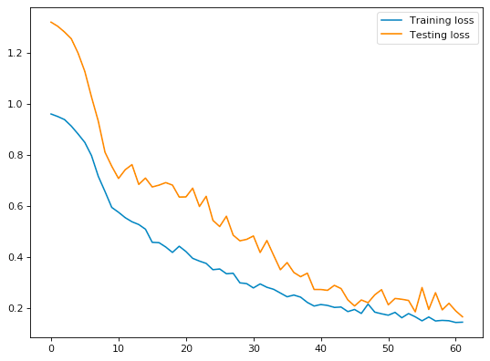
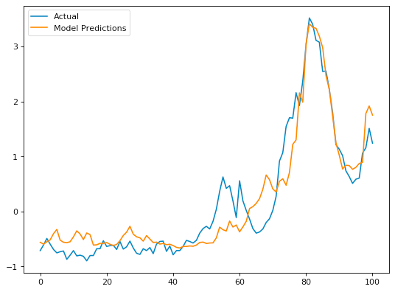
Loss and Predictions
Current Loss: 0.143
Notes:
These are our loss graphs. We stopped training at 60 epochs b/c anymore would result in overfitting.
After the model was fully trained, we asked it to predict the most recent 101 weeks of dengue cases taken from the testing data. And you can see what it predicted, which beats the baseline loss quite convincingly.

Slide 17
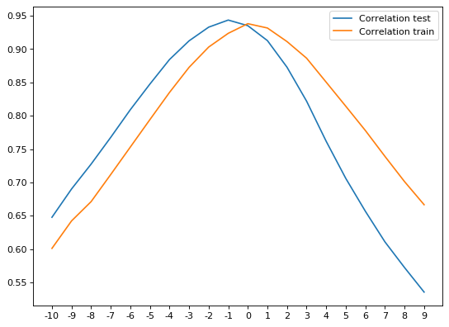
Testing for lag
What is autocorrelation?
“Autocorrelation is degree of similarity between time series and a lagged version of itself over successive intervals.”
Can see that max correlation is at -1, but correlation for -1 and 0 is similar
Notes:
We want to test if there is a lag in our predictions. For this we use autocorrelation.
Based on this, we see that there is a slight delay in our model predictions for the testing data set, with the ‘most similar’ predictions peaking when the predictions were shifted back -1 timesteps. However, it is not very significant as the correlation for -1 and 0 are very similar, which implies that the lag in the model predictions is not very severe.

Slide 18
Limitations
Notes:
Most weather stations were not operational through the entire time period (2000 onwards), so there were many missing weather data points.
Referencing the above graph, while the model was able to predict the spike in the testing dataset well (at time period 80), it was less accurate from time periods 20 to 40, when the dengue cases were more stagnant. This could suggest that the model tended to overestimate dengue cases when the dengue cases were low.

Slide 19
Thank You!

Slide 20
Quick Life Demo

